Slide 1

Pocket Date
Mobile & Web Application

Slide 2
Development Group 8
Project Manager
Henry Ton
Android Development
Austin Bryant - Lead Developer
Priyank Krishnamoorthi - Back end
Web Development
Lili Lin - Front end
Joe Hummel - Front end
Ming Jiang - Front end
Daniel Keller - Back end

Slide 3
What is Pocket Date???

Slide 4
About
Pocket Date is a speed dating app that guarantees users a match. When a user hits the “match” button, he/she will be paired with one other person based on their preferences and put into a chat. The pair may then view each other’s profiles and chat with each other, or choose to unmatch and find somebody else. Rinse and repeat until you find that perfect someone!

Slide 5
Lamp Stack
Linux
Apache
MySQL
PHP

Slide 6

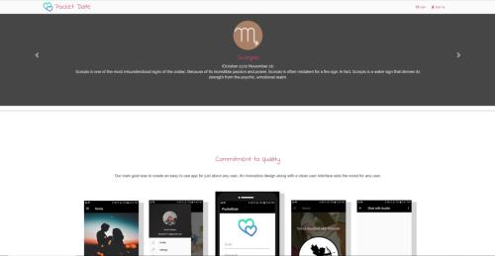

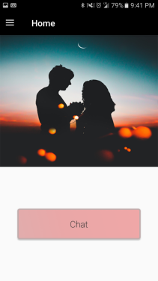
Mobile & Web Platform
Website Development: Used HTML, CSS, Javascript, PHP
Android Development: Used Android Studio, Java
The website allows people to create and edit their account and contains information about the app
With the app, people may create, ed

Slide 7
Technologies Used
Android Studio
Chatting API
Distance API (tested)
Blocking API
Matching API
Website
Script for updating the website
Account creation

Slide 8
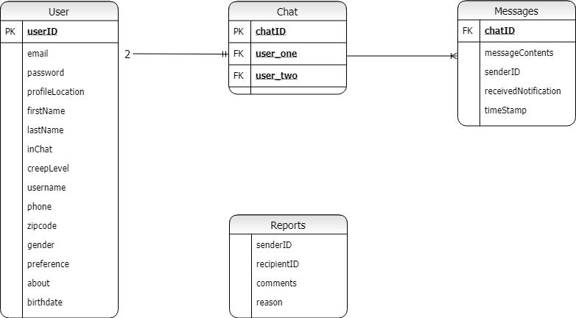
ER Diagram

Slide 9
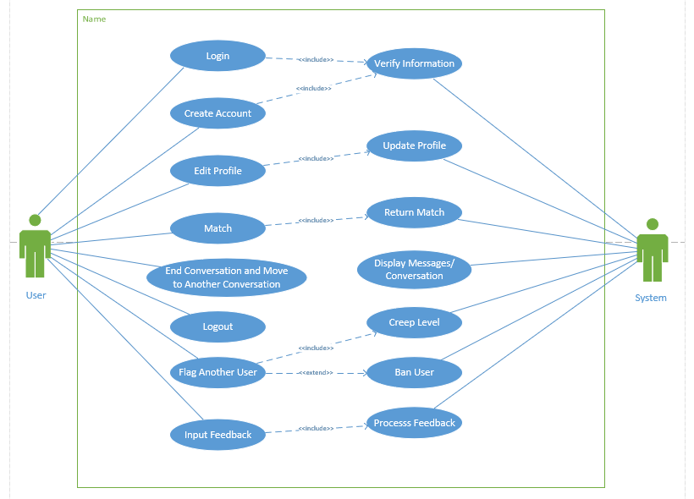
Use Case Diagram

Slide 10
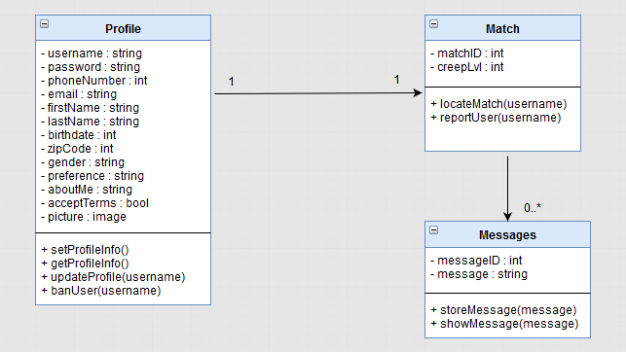
Class Diagram

Slide 11
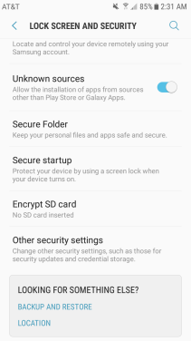
Demo!
http://cop4331groupeight.com

Slide 12
Difficulties
Lack of familiarity with Android Studio
Conflicting codes slowed down the debugging process
Distance API was buggy (temporarily disabled)
Google Chrome
Matching database parameters
Displaying profile picture properly on remote serverProf

Slide 13
Goals Reached
App is fully functional
Implemented several custom API’s
Learned how Android Studio works
Successful chatting interface
Perform queries on a database
Developed a support system for reports
Introduced creep level
Future Goals
Distance integration based on zip code
Age preferences
Making the app look really, really good
Optimizing the website for mobile use
Incorporate and generate matching coefficients between users
Address the issue of previously matched users
Email confirmation

Slide 14




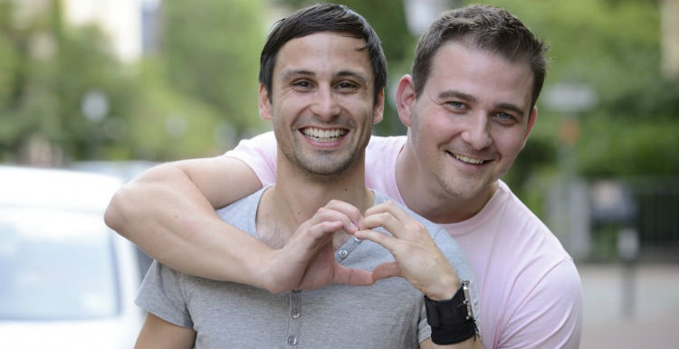

Questions?

